Slide 1
FINANCE LEARNING FORUM
Presented by Finance Department

Slide 2
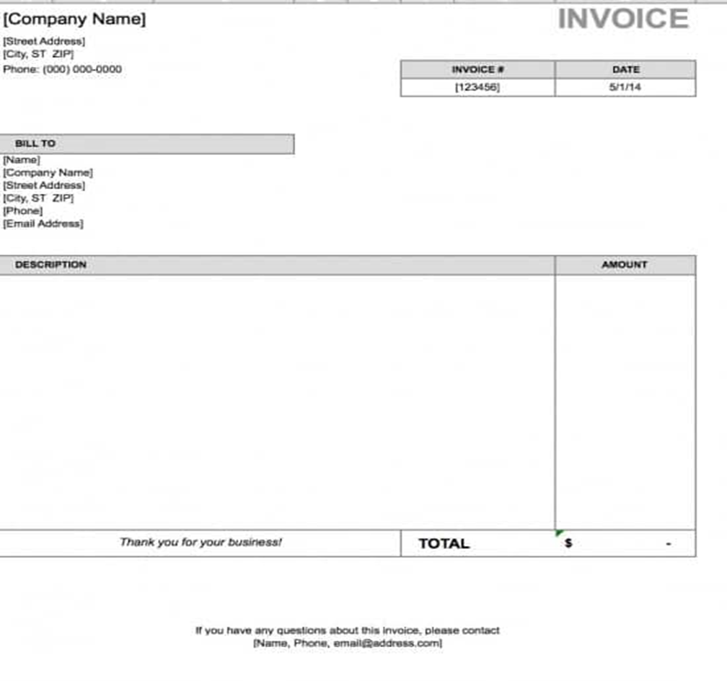
Accounts Payable
Invoices (Net 30 days)
Original Invoice
Authorization included
GL Budget account provided
USMC Procurement policy applied
Contract might be required

Slide 3
Accounts Payable
Employee expenses (Processing time 2 weeks upon receipt)
Backup documentation attached
Original receipt
Meals – Itemized receipt & No alcohol allowed (unless prior approval)
List of attendees
GL Budget account included
Authorization included

Slide 4
Accounts Payable
Sample Expense Reimbursement – GL account need to be filled by Department, see slides 12-14 for details
UNIVERSITY OF ST. MICHAEL'S COLLEGE - EXPENSE REPORT CDN $
Pay to: |  |  |  |  | Date Prepared:
Ref# or | Expense Details | Total |  |  | G. L. Account |  |  | Net | GST | OVAT
Date | (Attach original supporting receipts) | Expense¹ | GST ² | HST ² | Div | Dept | Acct | Expense | Recovered | Recovered
 |  |  |  |  |  |  |  | - | - | -
 |  |  |  |  |  |  |  | - | - | -
 |  |  |  |  |  |  |  | - | - | -
 |  |  |  |  |  |  |  | - | - | -
 |  |  |  |  |  |  |  | - | - | -
 |  |  |  |  |  |  |  | - | - | -
 |  |  |  |  |  |  |  | - | - | -
 |  |  |  |  |  |  |  | - | - | -
 |  |  |  |  |  |  |  | - | - | -
 |  |  |  |  |  |  |  | - | - | -
 |  |  |  |  |  |  |  | - | - | -
 |  |  |  |  |  |  |  | - | - | -
 |  |  |  |  |  |  |  | - | - | -
 |  |  |  |  |  |  |  | - | - | -
 |  |  |  |  |  |  |  | - | - | -
 | Total expenses this page: | - | - | - |  |  |  | - | - | -
 | Add balance forward from other pages:
 | Less cash advance: |  |  | Note 1: | Total expense is the amount to be reimbursed including taxes
 | Amount to be reimbursed: |  |  | Note 2: | If HST amount is shaded, amount entered for HST is not at 13% tax rate
 |  |  |  |  | If GST amount is shaded, amount entered for GST is not at 5% tax rate
Forward cheque to: |  |  |  |  | Special instruct:
Approved by: |  |  |  |  | Date:
Expenses should be approved by the one-up Manager / Supervisor.
Staff Expense Reimbursement might be held until it accumulates over $20.00.
USMC follows UofT Per Diem and Mileage rates. Please see attached for more details. |  |  |  |  |  |  |  |  |  | Rev 02/19
https://finance.utoronto.ca/wp-content/uploads/2018/01/Expense_Reimbursement_Checklist.pdf

Slide 5
Accounts Payable
 |  |  |  |  |  |  |  |  | DISBURSEMENT VOUCHER
PAYABLE TO : |  |  |  |  |  |  |  | DATE: |  | January 27, 2020
 |  |  |  |  |  |  |  | TO BE PAID BY:
PLEASE DESCRIBE COMPLETELY, AND SHOW ALL REFERENCES WITH ATTACHMENTS
APPROVALS (All approvals must be in print) |  |  |  |  |  |  | Allocation
 |  |  |  |  |  |  | Account # |  |  | Amount
Requested by:
Please confirm sufficient funds from budget:
Approved by:
 |  |  |  |  |  |  |  | TOTAL |  | $ -
Honorarium Request (Please provide Information as required)
Name:
Date of Birth: |  |  |  |  |  | SIN:
Address:
City: |  |  |  |  | Province: |  |  | Postal Code:
Purpose/
Event:
Special
Instructions:
Honorarium & Stipend payment (Processing time 2 weeks upon receipt)
Individual must provide:
First and last name
Date of Birth
SIN Number
Mailing address
GL Budget account
Authorization
* Urgent request must be submitted to Finance in person

Slide 6
Accounts Receivable
Payments can be received in:
Cash
Cheque
debit & credit card
wire transfer
Process frequency:
Cheques: at least twice a week
Cash: once a week
When submit payments, ensure:
backup is attached
GL number if applicable

Slide 7
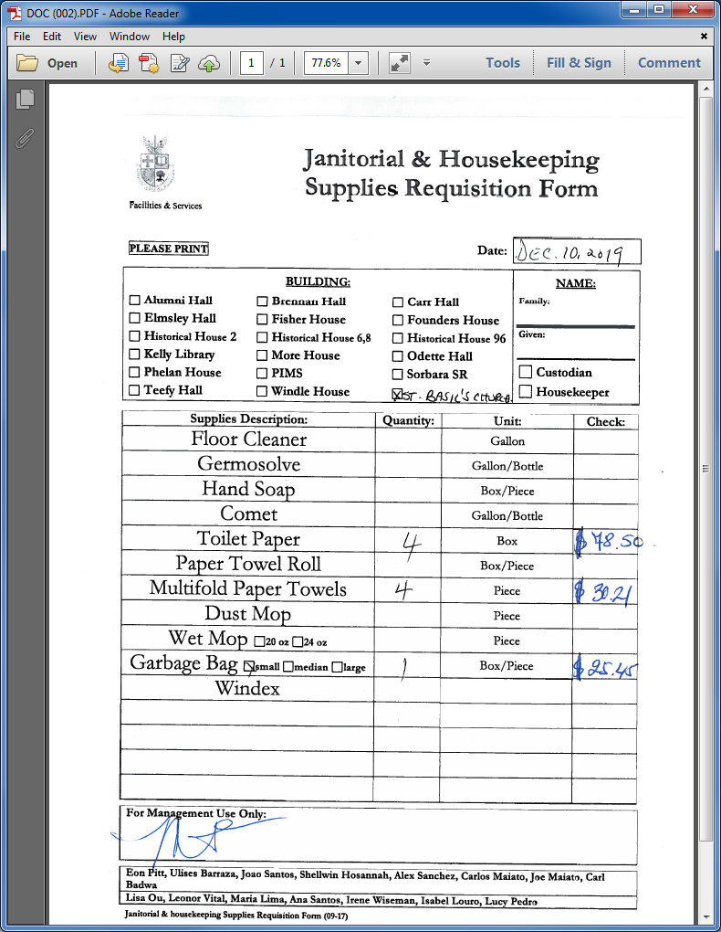
Accounts Receivable
When submit documents for invoicing:
supporting document
client name & address
detailed line item description
Amount
GL number

Slide 8
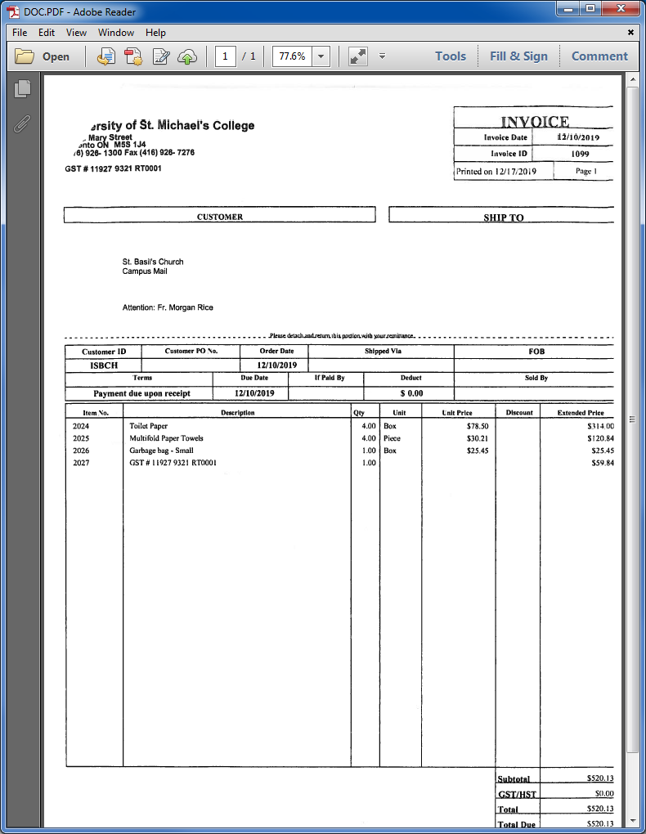
Accounts Receivable
Invoice Sample:

Slide 9
Payroll
New Hires
Require completed HR Hiring Form with relevant authorization
Difficult to pay new hire without relevant information such as:
Start date
Account code
Hourly rate
Benefits deduction
Employment status (FT, PT, Contract)
Employment Group
Tax deduction amounts
The completed HR Hiring Process Package will have the above information

Slide 10
Payroll
HR Hiring Form

Slide 11
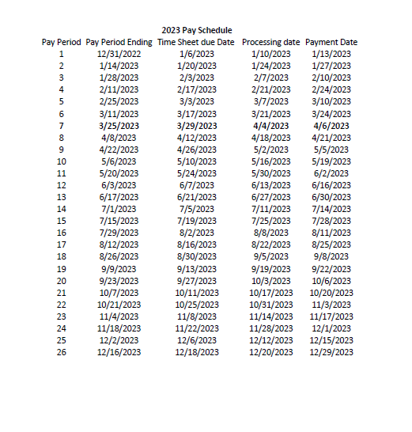
Payroll
2023 USMC Bi-Weekly
Payroll Schedule and
Due Dates

Slide 12
GL Accounts Structure
XX – XXXX - XXXX
↓ ↓ ↓ Revenue account starts with 4XXX
Fund Department Account Code →
Expense account starts with 5XXX
Operating Fund: 11-xxxx-xxxx
Expandable Fund:
21-0000-xxxx 21 funds project code starts with 1xxx
28-0000-xxxx Need provide project code 28 funds project code starts with 2xxx
31-0000-xxxx →→→→→ 31 funds project code starts with 3xxx
41-0000-xxxx 41 funds project code starts with 4xxx
50-0000-xxxx 50 funds project code starts with 5xxx

Slide 13
GL Accounts Structure
Department List |  |  | Account | Description
1113 | Audio Visual |  | 11-dept-5029 | Legal Fees
1140 | Principal |  | 11-dept-5031 | Professional Advisory Fees
1141 | Registrar |  | 11-dept-5106 | Honorarium
1216 | Theology - Academic |  | 11-dept-5112 | Recruitment
1242 | Theology Administration |  | 11-dept-5113 | Travel and Accommodation
1243 | Theology -MASI |  | 11-dept-5114 | Meals and Entertainment
1318 | Continuing Education |  | 11-dept-5115 | Membership and Association fees
1330 | Corporate Social Responsibility |  | 11-dept-5117 | Labour Relations
1425 | Student Life |  | 11-dept-5301 | Book Purchases
1444 | Alumni Affairs |  | 11-dept-5302 | Subscriptions
1445 | Development |  | 11-dept-5400 | Non Capitalized Equipment
1446 | Campaign |  | 11-dept-5401 | Equipment rental
2160 | Dean of Students |  | 11-dept-5402 | Equipment Maintenance
2270 | Food Services |  | 11-dept-5404 | Office Supplies
2383 | Parking |  | 11-dept-5406 | Printing (outsourced)
2384 | Summer Residence |  | 11-dept-5407 | Postage
2385 | Mail Room |  | 11-dept-5408 | Telephone
2386 | Information Technology |  | 11-dept-5410 | Computer Expenses (Toner)
3020 | Library |  | 11-dept-5411 | Computer Expenses non-capitalized
3150 | Housekeeping |  | 11-dept-5412 | Photocopy Paper
3151 | Physical Plant |  | 11-dept-5413 | Photocopy Charges
3152 | Groundskeeping |  | 11-dept-5415 | Miscellaneous Expense
3244 | Communication |  | 11-dept-5424 | Committee Costs
3245 | President's Office |  | 11-dept-5607 | Repairs and maintenance
3248 | Finance |  | 11-dept-5612 | External Contractors
3247 | Human Resources |  | 11-dept-5613 | Special Projects
 |  |  | 11-dept-5617 | Food Costs ( Internal Catering)
 |  |  | 11-dept-5624 | Room rental-External

Slide 14
